Slide 1

Group6 - Indoor Environment Monitoring
M.Sc Candidate. ITBE. Atacan Kural Avgoren
M.Sc Candidate. ITBE. Nayun Kim
M.Sc Candidate. ITBE. Keivan Tavakoli Panah
M.Sc Candidate. Env. -ing Maksim Khochinskii
Technische Universität München
Munich, 07. August 2023

Slide 2
Content
Geo Sensor Networks and the Internet of Things
TUM School of Engineering and Design
Technical University of Munich
Introduction (Maksim)
Observed location
hardware setup
Visualization (K1)
Grafana visualization
Data analysis (Atacan)
Threshold
avg
Problems and Solutions (Maksim)
disconnection
wrong observations
alert system
Further steps (Kim)
Mapping

Slide 3
Introduction
M.Sc Candidate Env. -ing. Maksim Khochinskii

Slide 4
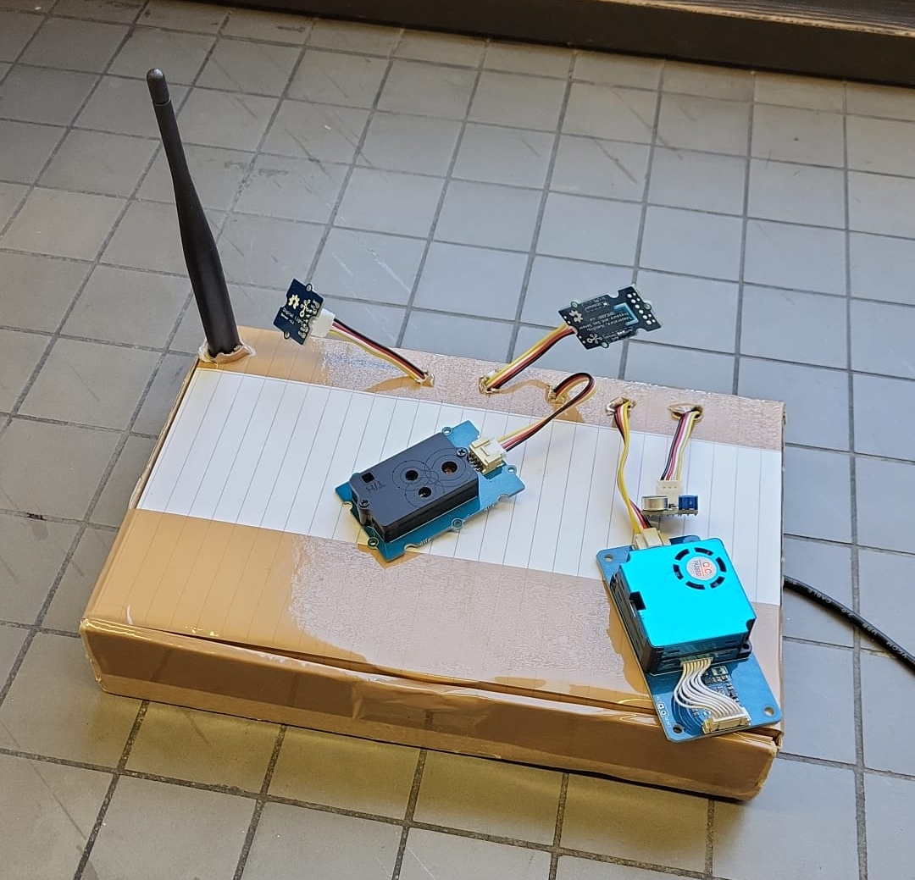
Introduction
Geo Sensor Networks and the Internet of Things
TUM School of Engineering and Design
Technical University of Munich
Develop an Indoor Ambient Monitoring system to visualize human comfort relevant environmental parameters like:
Temperature
Humidity SCD30
CO2 concentration
Illuminance Light Sensor V1.1(TSL2561)​
Loudness Loudness Sensor V0.9b
Dust (PM 2.5) Laser PM2.5 Sensor (HM3301)​
Volatile Organic Gas Sensor
compounds (VOC) (BME 680)​

Slide 5
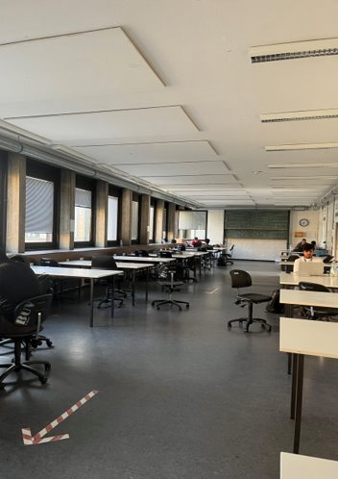
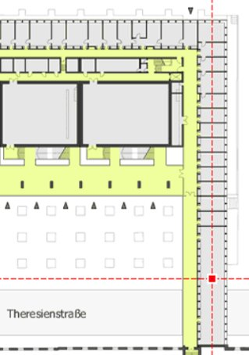
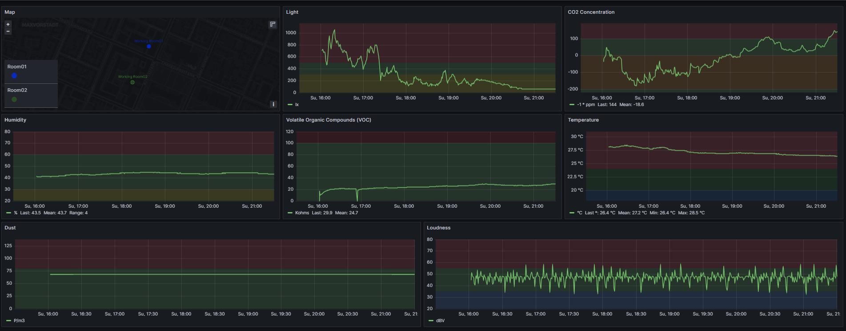

Introduction
Geo Sensor Networks and the Internet of Things
TUM School of Engineering and Design
Technical University of Munich
Room number: N1160​
Device placement dictated by CO2 sensor:​
Decoupling from external heat sources (incl. MC)​
Isolation from air flow​
Protection from sunlight ​
Device location
Source: Grafana Wikipedia
Source: TUM Room Finder

Slide 6
Visualization
M.Sc Candidate. ITBE. Keivan Tavakoli Panah

Slide 7
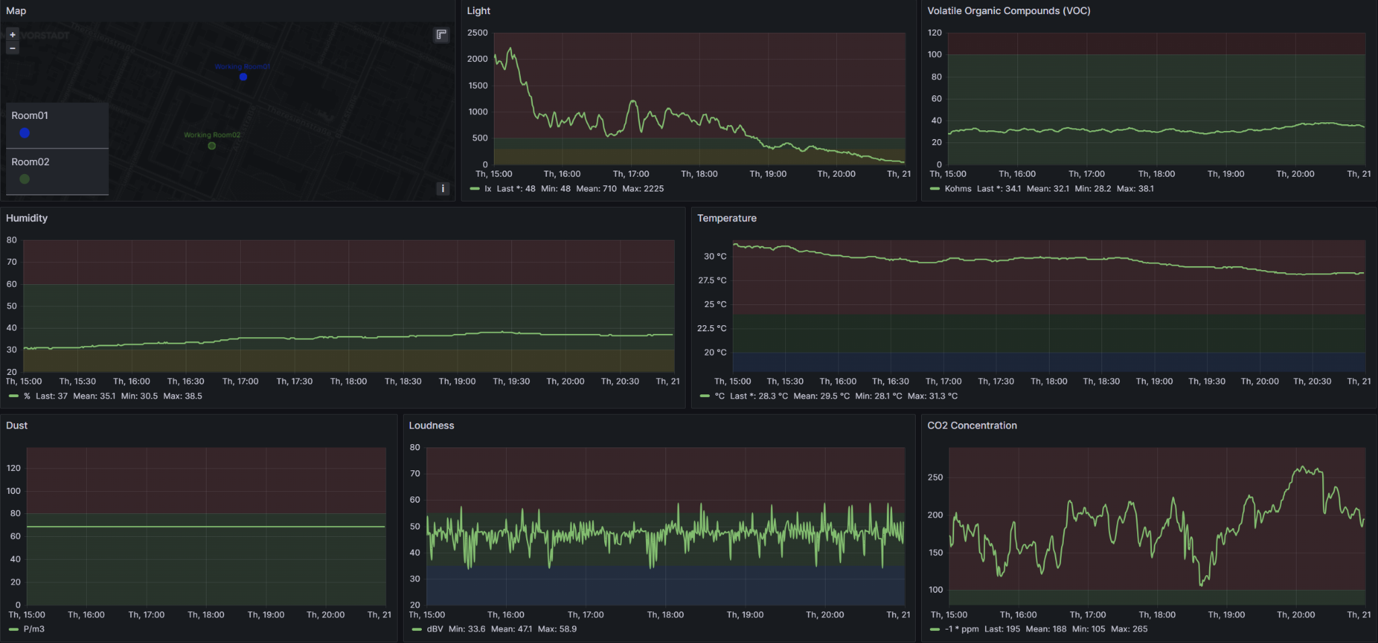
2. Visualization
Geo Sensor Networks and the Internet of Things
TUM School of Engineering and Design
Technical University of Munich

Slide 8
Data analysis
M.Sc Candidate ITBE Atacan Kural Avgoren

Slide 9
4. Data Analysis - Defining Thresholds
Geo Sensor Networks and the Internet of Things
TUM School of Engineering and Design
Technical University of Munich
Parameter | Recommended Range
Temperature | 20°C to 24°C
Relative Humidity | 30% to 60%
Noise Level | less than 35 dB(A) for sleeping areas, less than 55 dB(A) for general living areas
Brightness (Illuminance) | 300 to 500 lux for general activities, 500 to 1000 lux for reading and task-oriented activities
CO2 level | less than 350 ppm
Volatile Organic Compounds | less than 100 IAQ

Slide 10
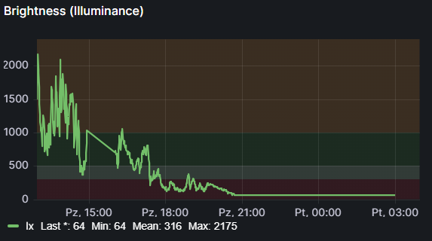
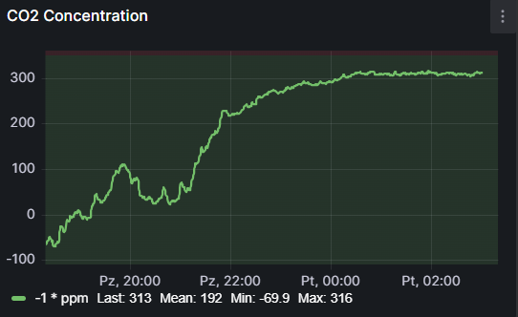
4. Data Analysis - Brightness - CO2 Concentration
Geo Sensor Networks and the Internet of Things
TUM School of Engineering and Design
Technical University of Munich
During the day, usually over recommended range
As day progress brightness is decreasing
Likely, CO2 concentration increases after closing windows
Within recommended range

Slide 11
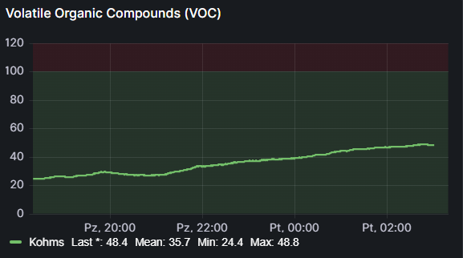
4. Data Analysis - CO2 Concentration and the VOC Gases
Geo Sensor Networks and the Internet of Things
TUM School of Engineering and Design
Technical University of Munich
The simultaneous increase of VOC gases and CO2 concentration within the same time frame may indicate a slowing of air circulation in the room, possibly due to the closing of windows.
Within recommended range
Within recommended range

Slide 12
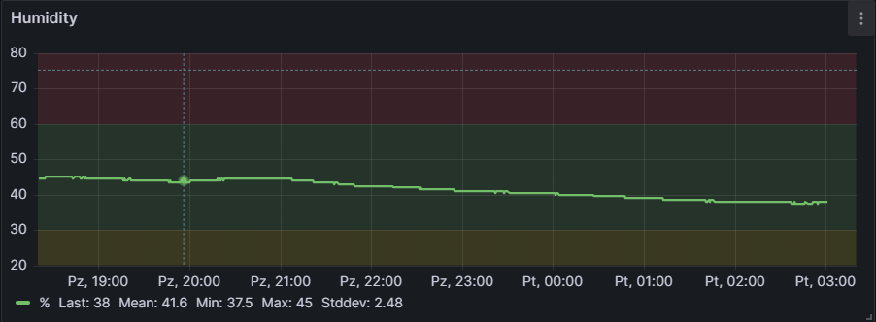
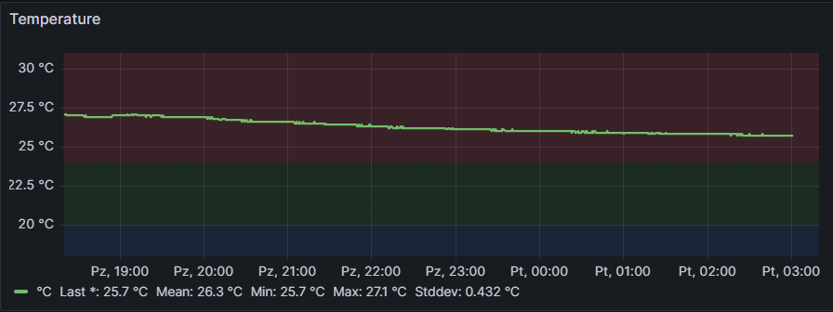
4. Data Analysis - Temperature and Humidity
Geo Sensor Networks and the Internet of Things
TUM School of Engineering and Design
Technical University of Munich
Within recommended range
As day progress both are slightly decreasing
Above recommended range

Slide 13
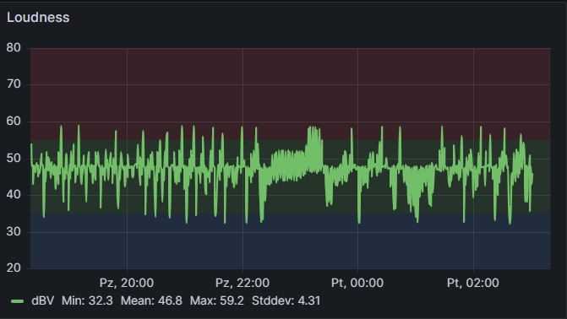
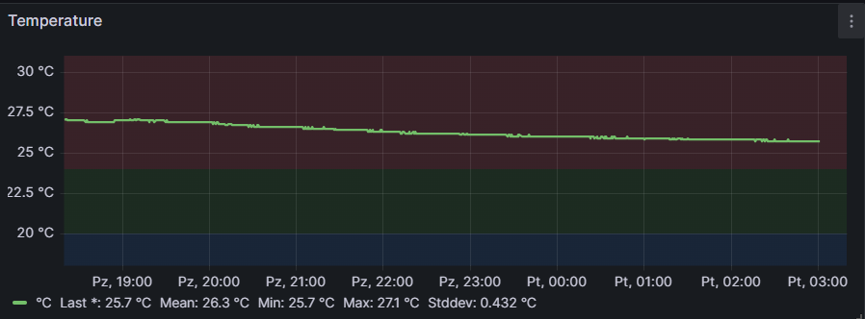
4. Data Analysis - Loudness - Temperature
Geo Sensor Networks and the Internet of Things
TUM School of Engineering and Design
Technical University of Munich
Highly variable data from loudness sensor, with high standard deviation
Considering inherits of these two data sets, it seems logic that one is volatile while the other undergoes slower changes
Data from temperature sensor exhibits gradual decline
Within recommended range

Slide 14
Problems & Solutions
M.Sc Candidate Env. -ing. Maksim Khochinskii

Slide 15
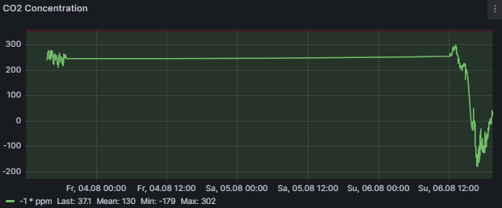
Problems and Solutions
Geo Sensor Networks and the Internet of Things
TUM School of Engineering and Design
Technical University of Munich
First problem: Disconnection
Possible reason: Solutions:
unstable connection with the gateway - reconnection/reload
- consider shorter period

Slide 16
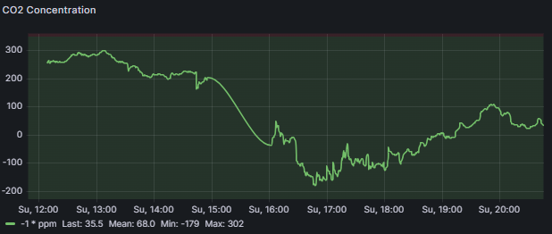
Problems and Solutions
Geo Sensor Networks and the Internet of Things
TUM School of Engineering and Design
Technical University of Munich
Second problem: Wrong observations
Possible reason:
issues with sensor
According to NOAA: August 04 - 421 ppm
Third problem: Not possible to create alerts ​with Grafana
Possible reason:
Not compatible data source (FROST)
Not possible to download plug-in (Alertmanager)

Slide 17
Further Steps - Extension to Map API
M.Sc Candidate. ITBE. Nayun Kim

Slide 18
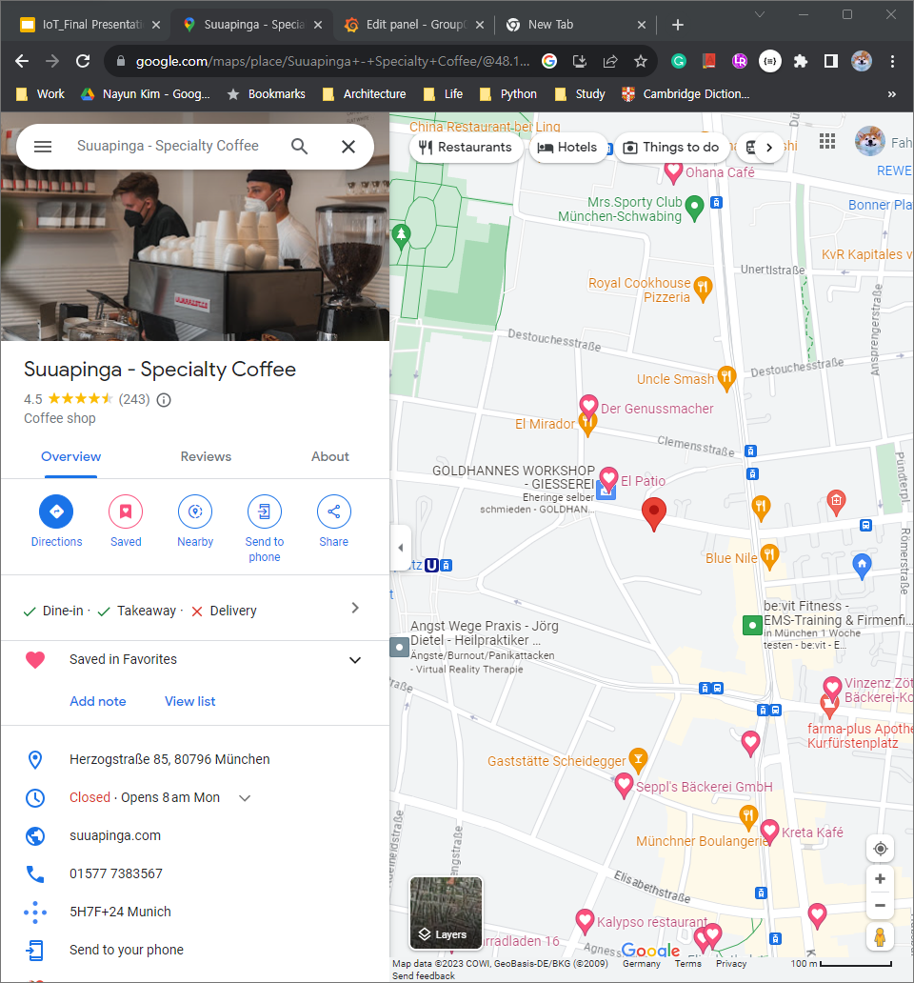
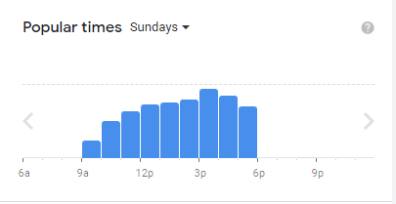
Further Steps - Map API
Geo Sensor Networks and the Internet of Things
TUM School of Engineering and Design
Technical University of Munich
e.g, Google Map api
location information
+ indoor environment situation
Location
observed area in Datastream
location in Location
Observations
Observation
Map Visualization
Geomap in Grafana
FROST API
FROST API v1.1
FROST JSON API v1.1
Notes:
crowdness
limited to search about the indoor situation

Slide 19
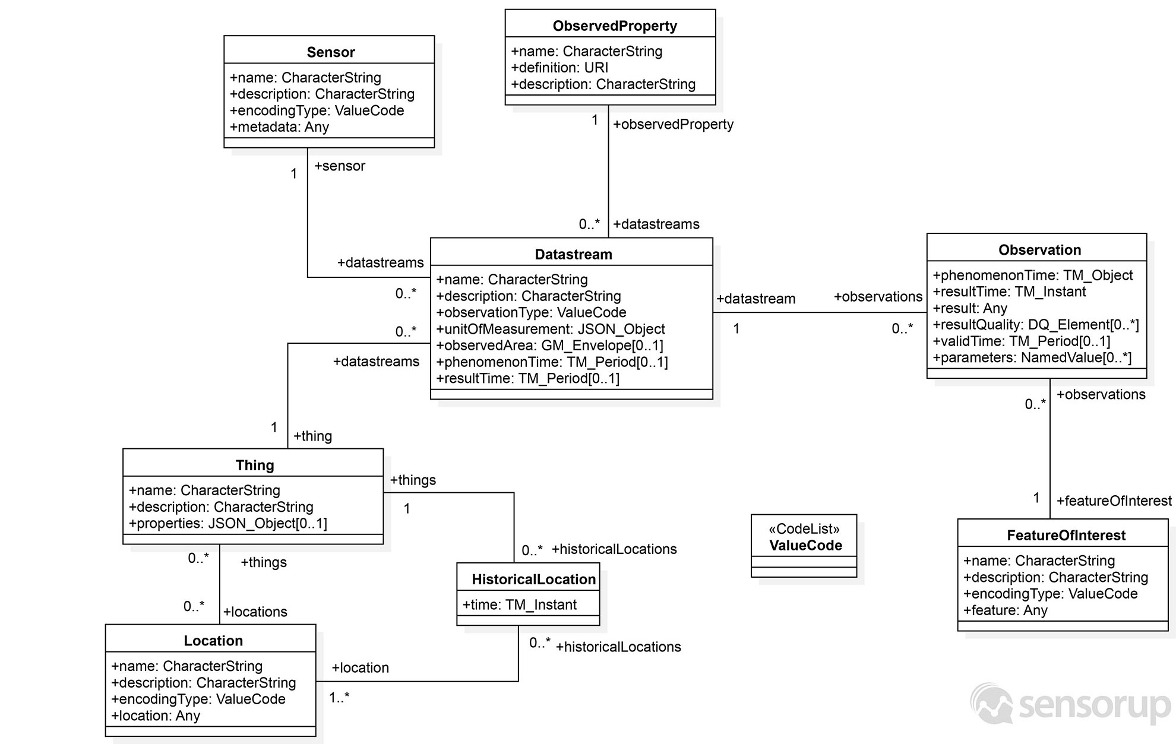
Problems - SensorThing API Architecture
Geo Sensor Networks and the Internet of Things
TUM School of Engineering and Design
Technical University of Munich
Limitation of Sensorthing architecture
Different Address of Location and Data stream
Not stored both in the same address
Grafana basic visualization interface
Only visualize queried data
A geometry visualizes a queried data from a single path
Grafana GI3 - FROST API
Mainly for Datastreams
Notes:
there are 2 way to access to location information from sensorthing api
one from the location attribute from location class
one from the observed are from the datastream
but thing is that the the path to the location and observation are different
and this can make harder to visualize them in geomap in grafana.

Slide 20
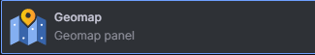
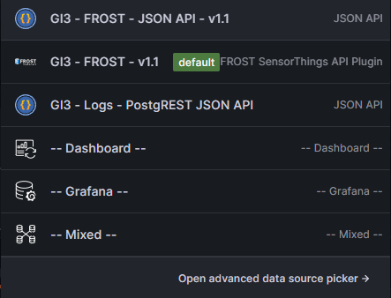
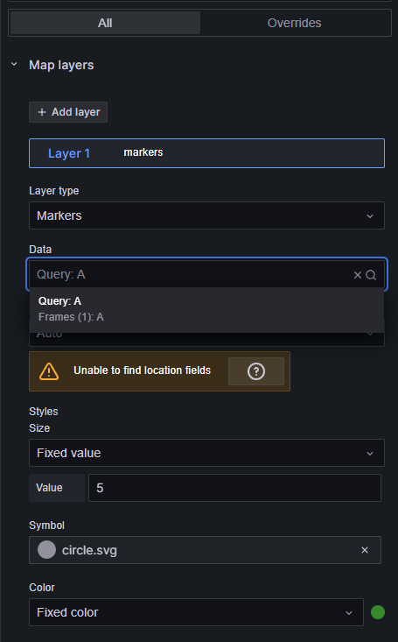
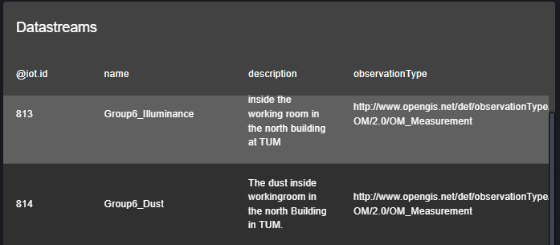
Problems - FROST v1.1 API and Geomap
Geo Sensor Networks and the Internet of Things
TUM School of Engineering and Design
Technical University of Munich
Limitation of Sensorthing architecture
Different Address of Location and Data stream
Not stored both in the same address
Grafana basic visualization interface
Only visualize queried data
A geometry visualizes a queried data from a single path
Grafana GI3 - FROST API
Mainly for Datastreams
Notes:
because firstly FROST API actually focuses on querying the datastreams. even we can query other information with advanced option, but still limited to query the specific attribute.
and also the geomap only can visualize the queried data from the single path , so that means that the path should be same to visualize them in a same geometry.

Slide 21
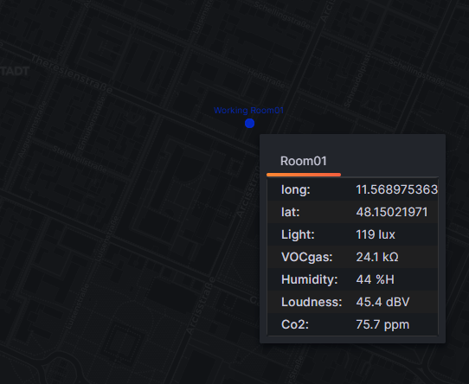
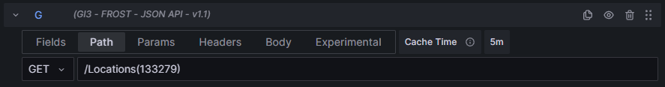
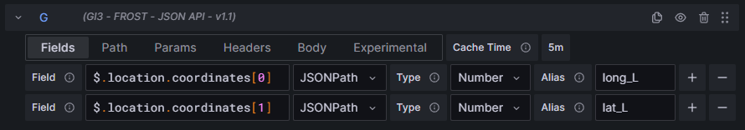
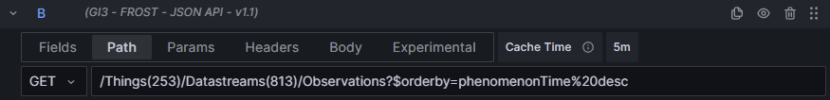
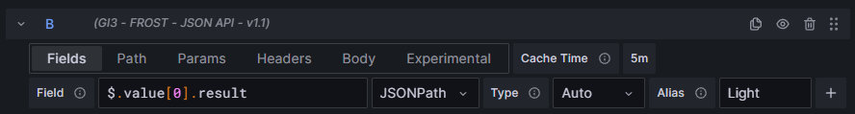
Solution - FROST JSON API v1.1
Geo Sensor Networks and the Internet of Things
TUM School of Engineering and Design
Technical University of Munich
GI3 FROST JSON API v1.1
QueryG: Longitude and latitude
path: /location(133279)
QueryABC…: Light Observations
path:/Datastreams(81x)/Observations
Ordered descend
Merge fields into single frame by transformation in Grafana
Visualize them in the same geometry

Slide 22
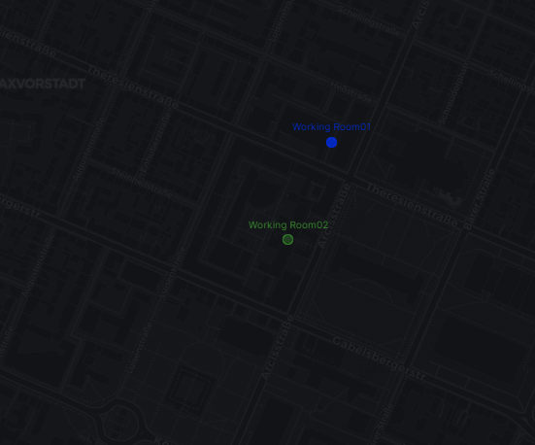
Extension - Add other locations
Geo Sensor Networks and the Internet of Things
TUM School of Engineering and Design
Technical University of Munich
Further Steps
integrate with existing location information
google map api
open street map api
assigned the non-DB data
improve the visualization
additional plug-in from GrafanaCL

Slide 23
References
Geo Sensor Networks and the Internet of Things
TUM School of Engineering and Design
Technical University of Munich
Monthly Trends in Atmospheric Carbon Dioxide Website: NOAA Global Monitoring Laboratory URL: https://gml.noaa.gov/ccgg/trends/monthly.html Accessed: August 05, 2023.
Grafana Website: Wikipedia URL: https://en.wikipedia.org/wiki/Grafana Accessed: August 05, 2023.
TUM Room Finder Map Website: Technical University of Munich (TUM) Portal URL: https://portal.mytum.de/campus/roomfinder/roomfinder_viewmap?mapid=12&roomid=N1160@0101 Accessed: July 28, 2023.

